Slide 1


PROJECT TOPIC NAME
RNS INSTITUTE OF TECHNOLOGY
BENGALURU - 98
DEPARTMENT OF INFORMATION SCIENCE & ENGINEERING
DBMS MINI PROJECT SEMINAR
By
NAME1 NAME2
USN1 USN2
Under the guidance of
FACULTY INCHARGE LAB INCHARGE
Mr.Guide name Mrs. Kusuma S
Assistant Professor, Assistant Professor,
Department of ISE, RNSIT

Slide 2
AGENDA
Abstract
Introduction
Front end and Back end tools
ER-Diagram
ER to Schema Mapping
Schema Diagram
Tables description with Normalization
Stored Procedures and Triggers
Results
Snapshots
Applications
Conclusion
References
Department of ISE, RNSIT

Slide 3
ABSTRACT
Department of ISE, RNSIT

Slide 4
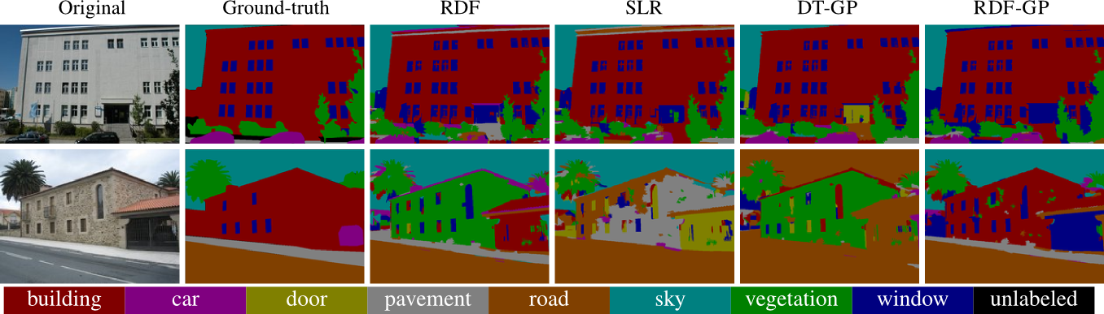
INTRODUCTION
Department of ISE, RNSIT

Slide 5
INTRODUCTION CONTD.
Department of ISE, RNSIT

